Slide 1
SWAMI VIVEKANAND COLLEGE OF ENGINEERING, INDORE
COMPUTER SCIENCE AND ENGINEERING DEPARTMENT
SESSION : JAN-JUNE 2018
PROJECT TITLE:
EMOTION RECOGNIZING MUSIC PLAYER
Guided By:
Ms. Karishma Mandloi
Department of CSE
SVCE, Indore
Presented By:
Anubhuti Bhargava
(0822CS141013)

Slide 2

Outline
Abstract
Introduction
Problem Domain
Literature Survey
Solution Domain
System Domain
Application Domain
Limitations
Expected outcome
References

Slide 3
Abstract
• The study of music and emotions suggests that there is a psychological relationship between a person’s emotional state and the type of music they listen to.
• The purpose of this project is to make an interactive music player that automatically generates a playlist according to the current mood of the user.
• The song playlists though are, at times too large to sort out . It would be helpful if the music player was “smart enough” to sort out the music based on the current state of emotion the person is feeling.

Slide 4
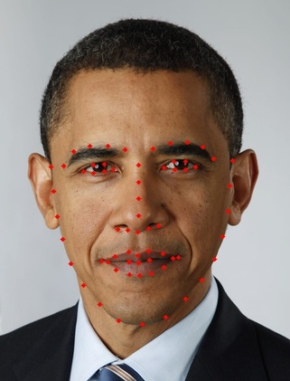
Introduction
• Facial expressions are a great indicator of the state of a mind for a person. Indeed the most natural way to express emotions is through facial expressions.
• Humans tend to link the music they listen to, to the emotion they are feeling.
• We will be using facial landmarks and a machine learning algorithm, and see how well we can predict emotions in different individual.
Using Facial Landmarks is another approach to detecting emotions, more robust and powerful than the earlier used fisherface classifier, but also requiring some more code and modules.

Slide 5
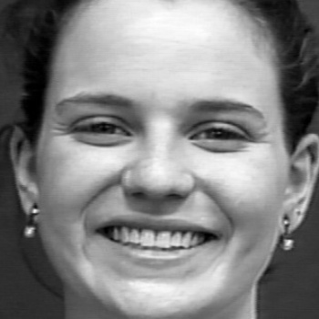
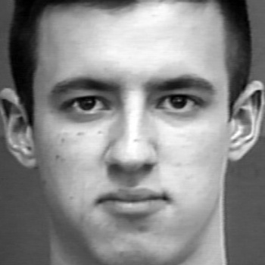

• For detecting the emotion of an individual, We need to do a few things:
→ Get images from a webcam
→ Detect Facial Landmarks
→ Train a machine learning algorithm (we will use a linear SVM)
→ Predict emotions
• We are training our model to identify 3 emotions:
1) Happiness.
2) Neutral.
3) Sadness.
Happiness
Neutral
Sadness

Slide 6
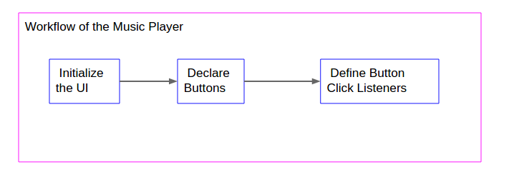
• Once the emotion is recognized, half of our task is done.
• The next step is to make a user interactive music player. Our music player will automatically generate list of songs belonging to that particular genre.
• The user will have the options to stop the song, play next song, play previous song, etc.

Slide 7
Problem Domain
• Generally people have a large number of songs in their databases.
• People randomly select a song from their playlists and the given song might not be appropriate for the current mood of the user and might disappoint them.
• In current music player systems, user has to choose the songs from the entire playlist that matches the current mood of the user. This process is very time consuming.

Slide 8
Solution Domain
• The proposed system is based on extraction of facial expressions that will automatically
generate the playlist thereby reducing the time and efforts of the user to choose the
appropriate song that corresponds to his/her current mood.
• The user will have the option to change the current playing song and switching to another
one.
• The users will get rid of the traditional method of the song selection and hence this will
provide users a whole new experience for listening their favourite music.

Slide 9
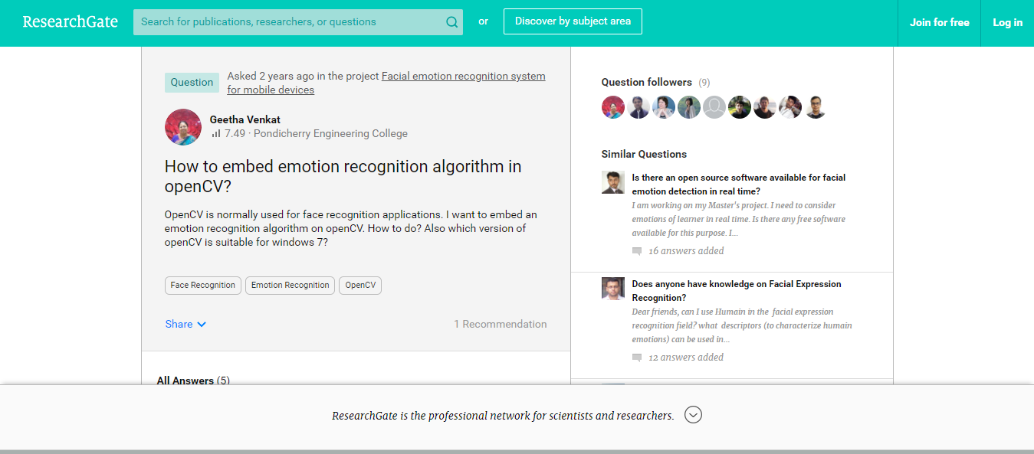
Literature Review
The idea for this project is taken from the blogs and research topics from the
websites like researchgate.org, stackoverflow.com, etc.

Slide 10
System Domain
ALGORITHMS
SOFTWARE
HARDWARE
TECHNOLOGY STACK :
The language I’ll be using is PYTHON.
→ Following python dependencies will be required :
• Sklearn
• Dlib
• Open CV
• Tkinter
• Pygame
• Mutagen
• Some other python libraries
System dependencies :
• Python 3.6
• Anaconda distribution
• OS: Windows 7 or higher/Ubuntu
• CPU : Intel i3 or higher
• GPU : Any GPU that is compatible with OpenGL 3.2(NVIDIA GEFORCE recommended)
• RAM : 4 GB minimum(8 GB recommended)
• Web camera

Slide 11
Application Domain
• This app can be used by people of any age group who want to have a whole new
experience for listening their favourite music.
• Further more features and emotions will be added in the music player to make it more interactive for the users.

Slide 12
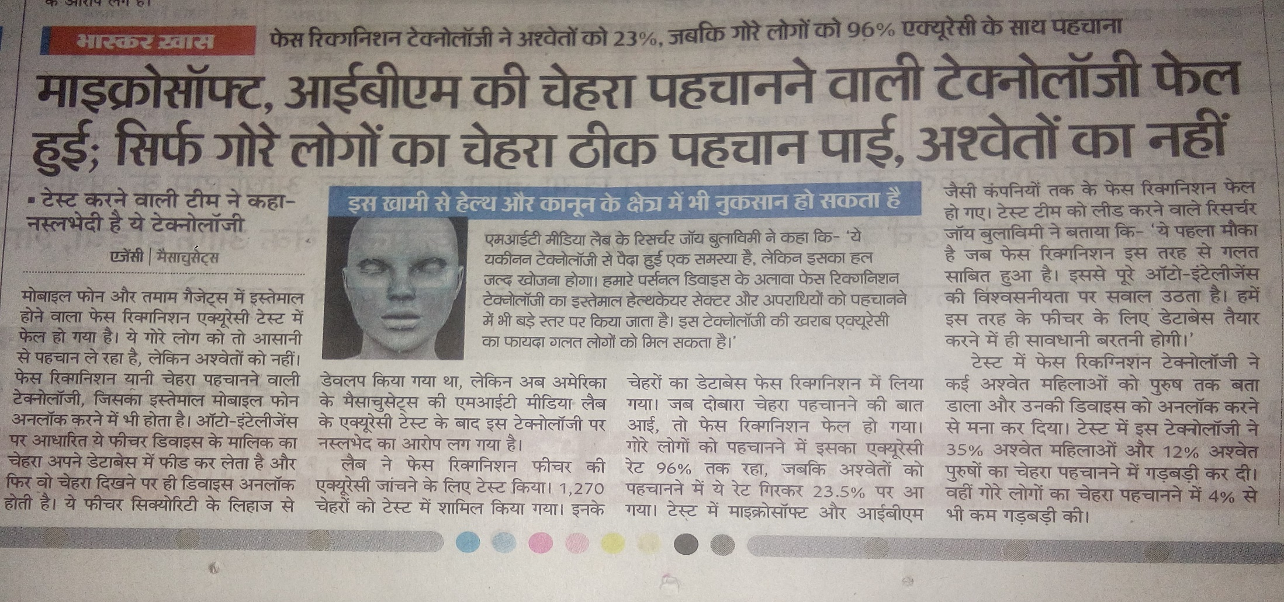
Limitations
• The biggest limitation for this application will be the inaccuracy issues. The current
machine learning models are not accurate enough to predict emotions with 100%
accuracy.

Slide 13
EXPECTED OUTCOME
• Easily used.
• New experience for users.
• Will be less time consuming and more user friendly.
• The user interface will provide the users choice to change songs as per their
need.

Slide 14
References
https://www.researchgate.net/post/How_to_embed_emotion_recognition_algorithm_in_openCV
http://www.paulvangent.com/2016/08/05/emotion-recognition-using-facial-landmarks
http://www.tkdocs.com/tutorial

Slide 15
THANK YOU…

